Slide 1

ASP.NET CORE Overview

Slide 2

Who is this person?
Abhishek Gupta
Azure Architect
abhishek.msft@outlook.com
@AbhiForTweeting

Slide 3
A Quick Overview of ASP.NET Core

Slide 4
Evolution of ASP and ASP .NET
Active Server Pages
(Classic ASP)
Active Server Pages
(Classic ASP)
ASP.NET
MVC
1/2/3/4/5
ASP.NET
MVC
1/2/3/4/5
ASP.NET
MVC 6
Unified MVC, Web API and Web Pages
ASP.NET
(Web Forms)
ASP.NET
MVC 6
Core MVC
Unified MVC, Web API and Web Pages
ASP.NET
(Web Forms)
ASP.NET
Web Pages
ASP.NET
Web Pages
ASP.NET
Web API
ASP.NET
Web API

Slide 5
Names & Version Numbers
ASP.NET
MVC 6
C# 6.0
ASP.NET
MVC 6
Core MVC
C# 6.0
ASP.NET 5
(runs on .NET Core 5 or .NET Framework 4.5.2+)
ASP.NET 5 Core 1.0
(runs on .NET Core 5 1.0
or .NET Framework 4.5.2+)
SignalR 3
SignalR 3
.NET Framework 4.6
.NET Core 5
.NET Framework 4.6
.NET Core 5
.NET Core 1.0

Slide 6
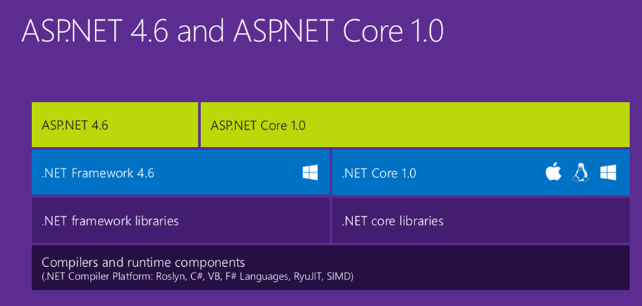
ASP.NET Core High-Level Overview

Slide 7
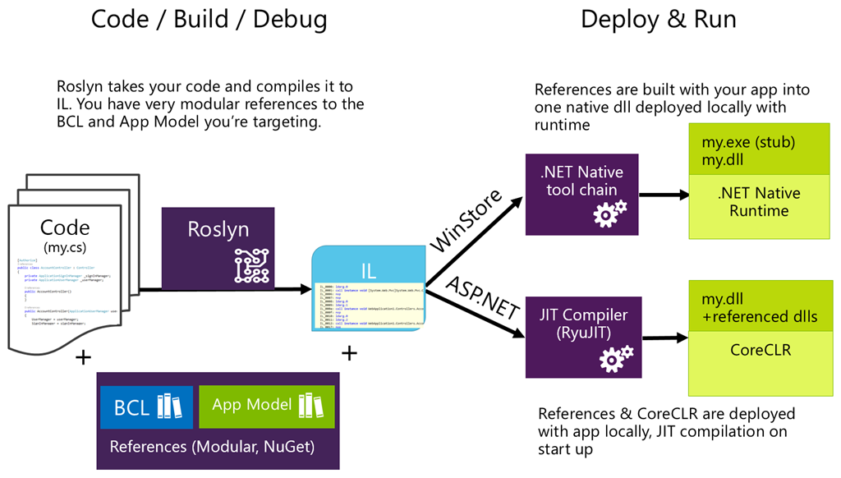
Compilation Process

Slide 8
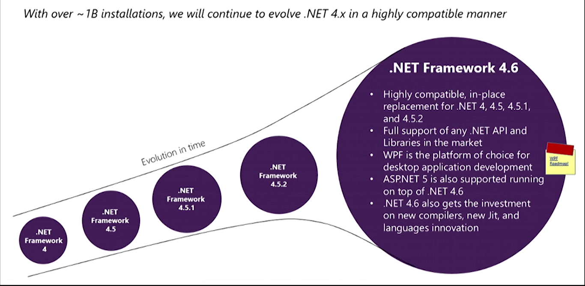

What About .NET Framework 4.6?

Slide 9
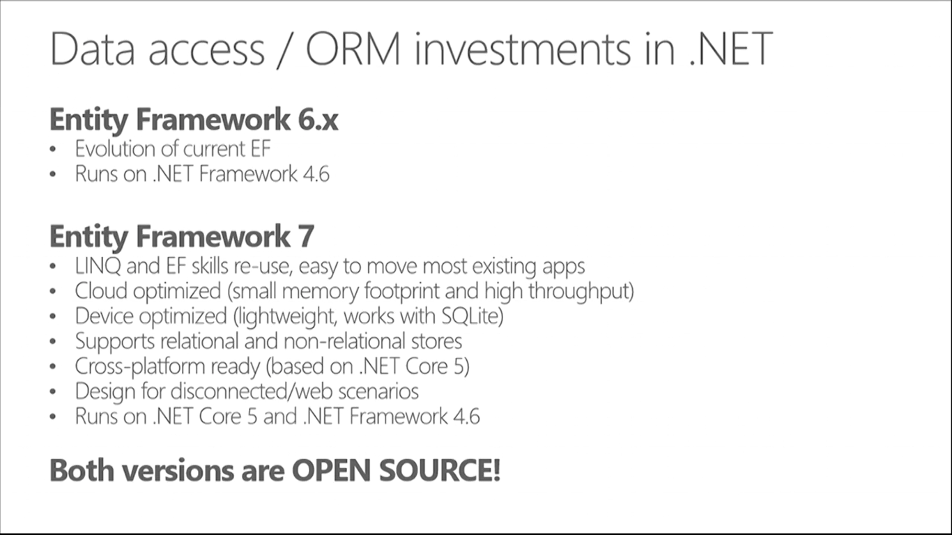
How about Entity Framework?
Entities in Code
ORM
DB

Slide 10
MVC and Web API

Slide 11
ASP .NET Architecture
Sites
Services
Web Forms
MVC + Web Pages + Web API
SignalR
ASP.NET

Slide 12
Model-View-Controller
Request
Controller
Update
Update
View
Model
Get Data From

Slide 13
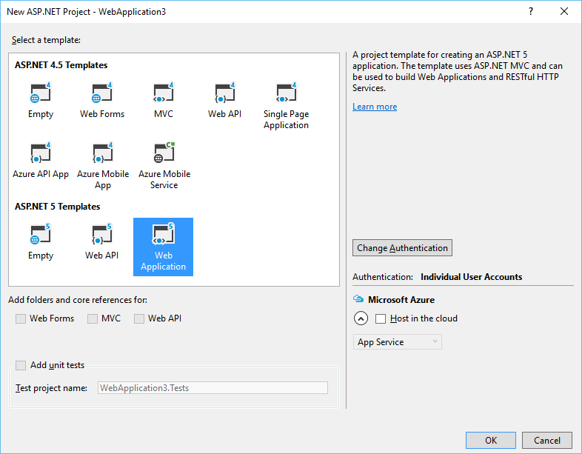
ASP.NET MVC Web Project Template

Slide 14
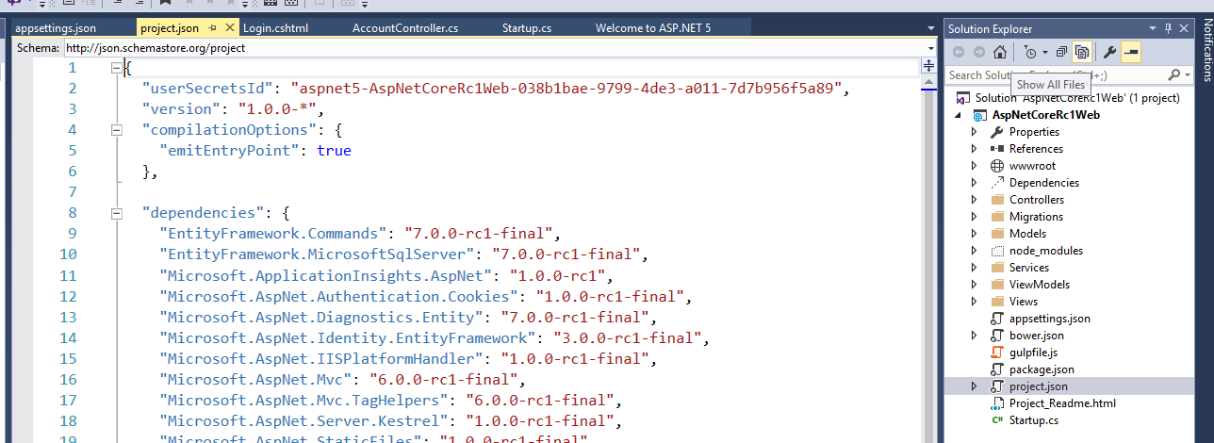
Project Files and Configuration

Slide 15
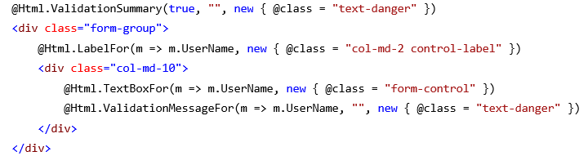
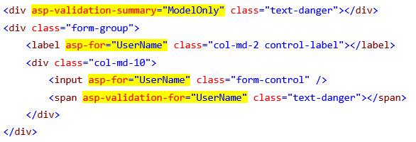
Tag Helpers: Evolution of HTML Forms

Slide 16
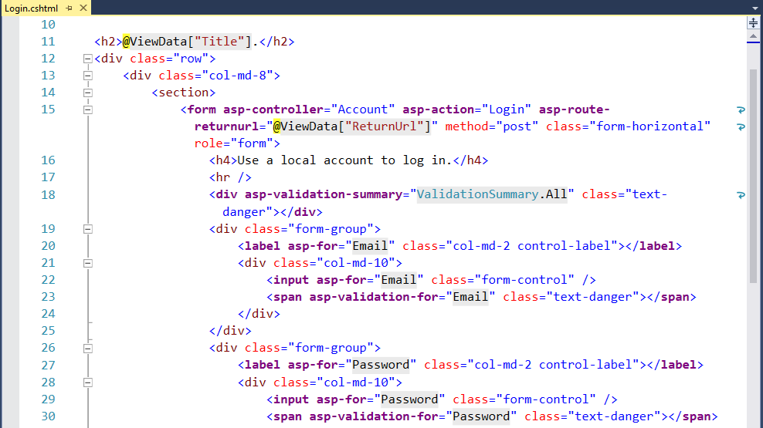
Tag Helpers in Views

Slide 17
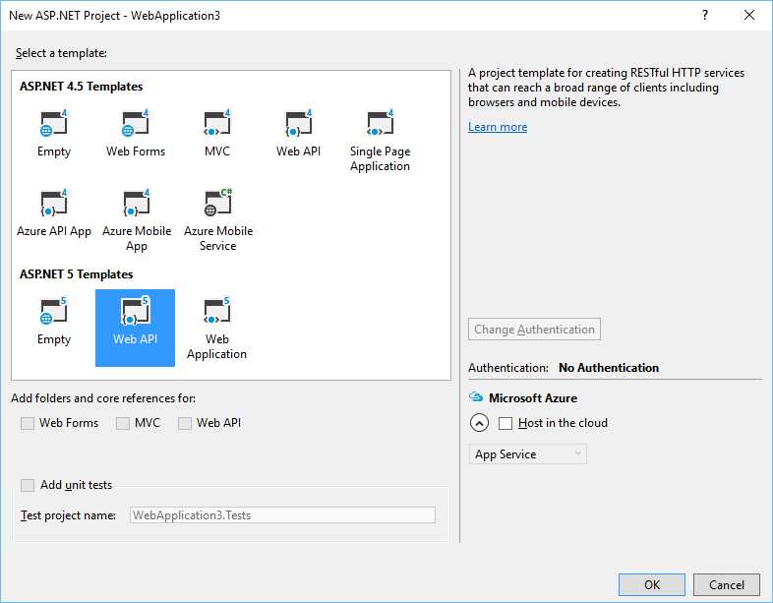
ASP.NET Web API Project Template

Slide 18
Consuming Web APIs
Web API
MVC App
HTML5 App
Mobile App

Slide 19
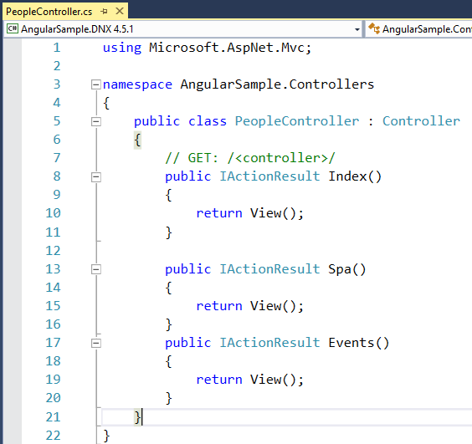
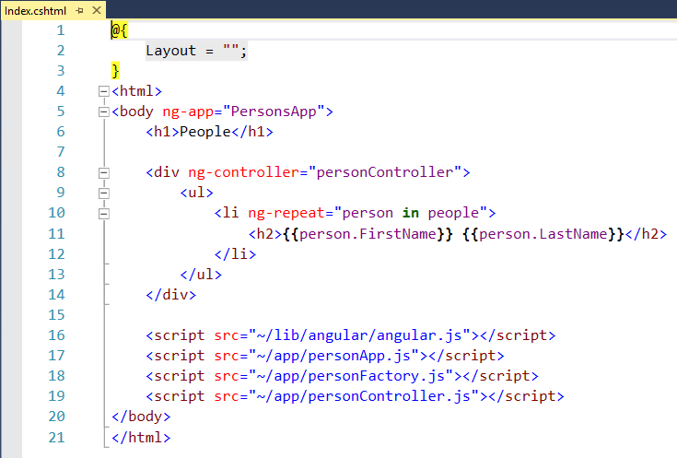

Controller -> View -> Web API
https://github.com/aspnet/Docs/tree/master/aspnet/client-side/angular/sample/AngularSample

Slide 20
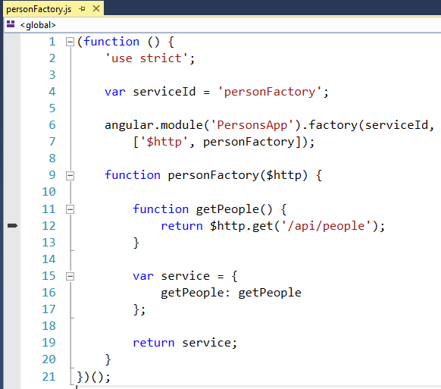
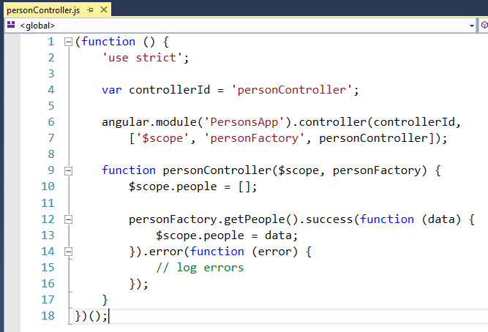
Angular App

Slide 21
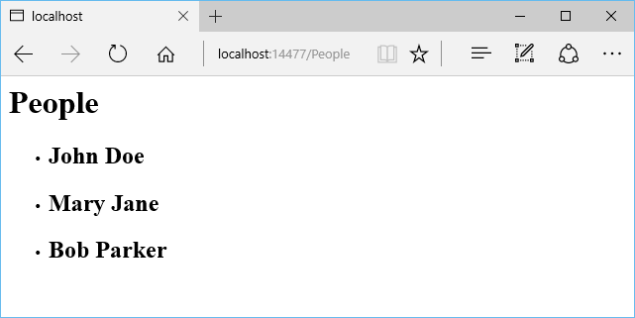
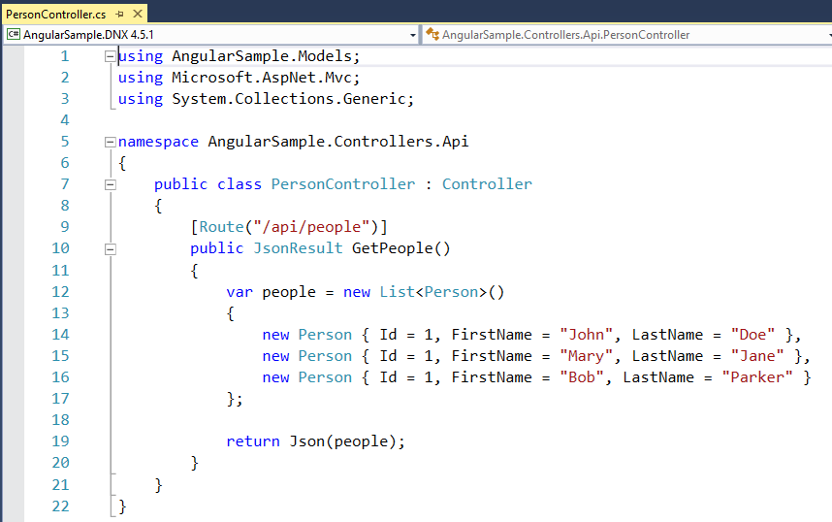
Web API Controller

Slide 22
References
http://bit.do/arch-aspnetcore2ebook
https://docs.microsoft.com/en-us/dotnet/standard/modern-web-apps-azure-architecture/
https://docs.microsoft.com/en-us/aspnet/core/tutorials/first-web-api
https://docs.microsoft.com

Slide 23


Slide 24
Let’s connect
Abhishek.msft@outlook.com
@AbhiForTweeting
http://CloudAndMobileBlog.com

